Slide 1
HEART DISEASE PREDICTION USING MACHINE LEARNING
PRESENTED BY:
KUMMARI ANUSHA
DOMAIN: MACHINE LEARNING & AI

Slide 2
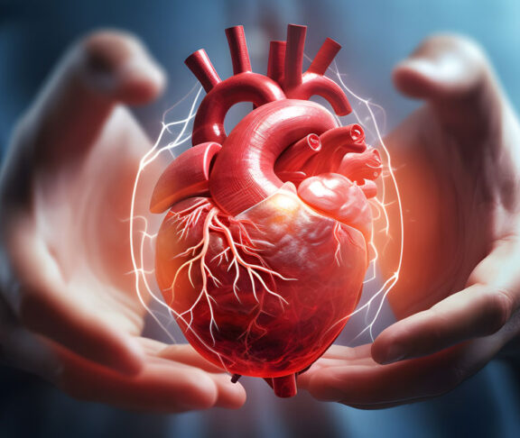
Problem Statement
Heart disease is one of the leading causes of mortality worldwide. Early prediction can significantly improve treatment outcomes and support timely medical intervention. This project aims to develop a machine learning model that predicts the likelihood of heart disease using patient medical data.

Slide 3
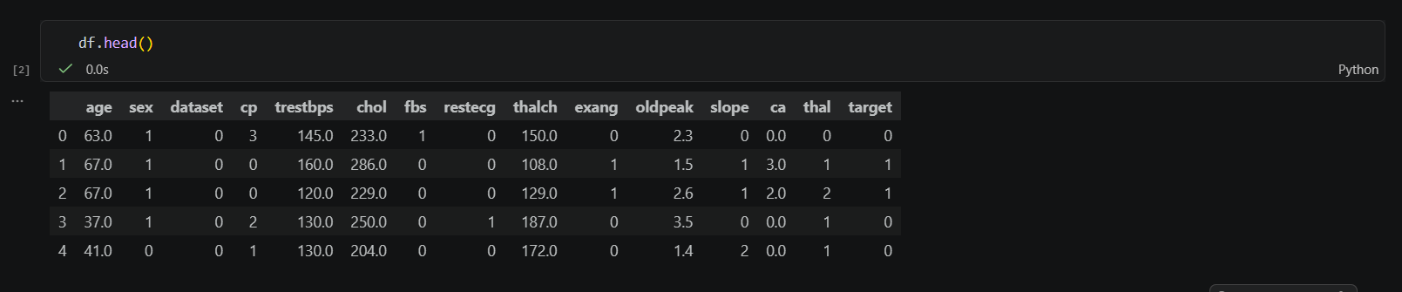
Dataset Overview
Dataset Source : UCI Heart Disease Dataset
Dataset Information
📊 Records: 920
📋 Features: 16
🎯 Target: Heart Disease
Key Features
Age
Blood Pressure
Cholesterol
Chest Pain Type
Maximum Heart Rate

Slide 4
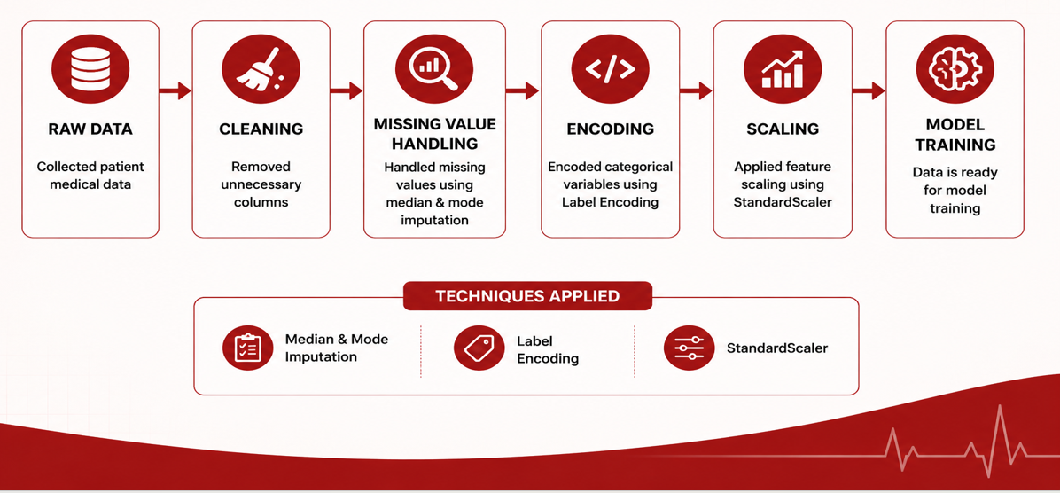
Data Preprocessing
First bullet point here
Second bullet point here
Third bullet point here

Slide 5
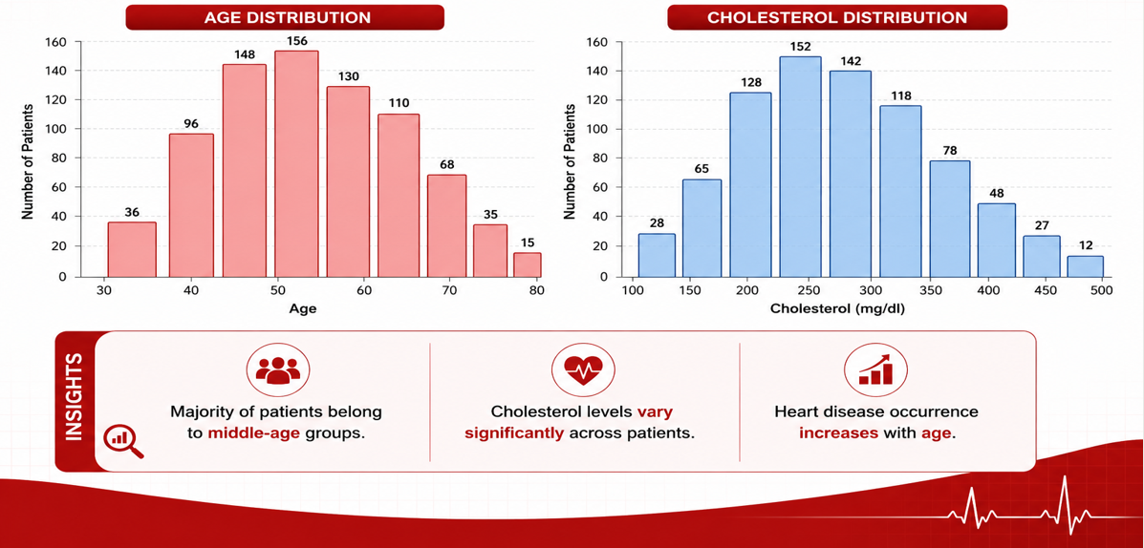
Exploratory Data Analysis

Slide 6
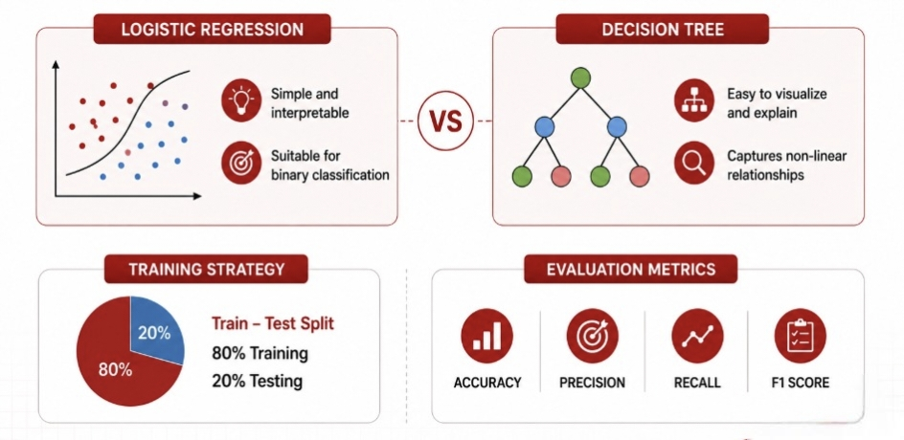
Model Building

Slide 7
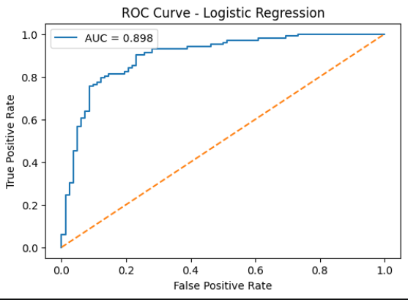
Logistic Regression Results
Logistic regression worked best, hitting an accuracy of 84.24% and an AUC score of 0.91. This shows a very reliable prediction model for heart disease.

Slide 8
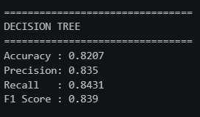
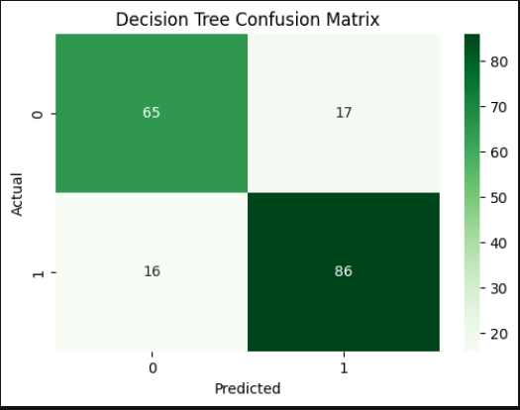
Decision Tree Results
Decision Trees did well too, nabbing an accuracy of 82.07% and spotting how features interconnect

Slide 9
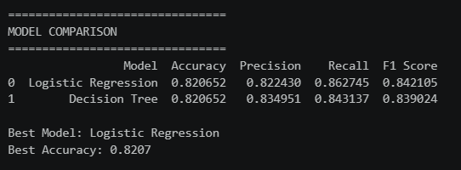
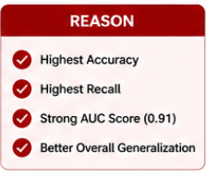
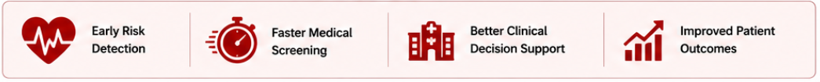
Model Comparison & Business Impact
BUSINESS IMPACT
These models help medical pros spot at-risk folks early on, letting them step in and boost patient results.

Slide 10
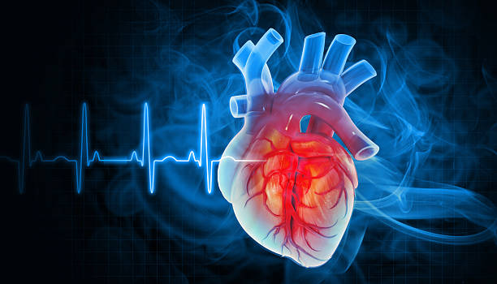
Conclusion
Future Scope
I successfully developed a Machine Learning model for predicting heart disease. I did data preprocessing, feature scaling, and analysis. I also implemented and evaluated Logistic Regression and Decision Tree models. Logistic Regression performed better, achieving 84.24% accuracy and an AUC score of 0.91. This model could help with early disease detection and support decisions in healthcare.
For future work, I'd look into Random Forest and XGBoost methods, and explore Deep Learning models too. Real-time hospital integration and creating a web or mobile based prediction system would be awesome!

